Slide 1
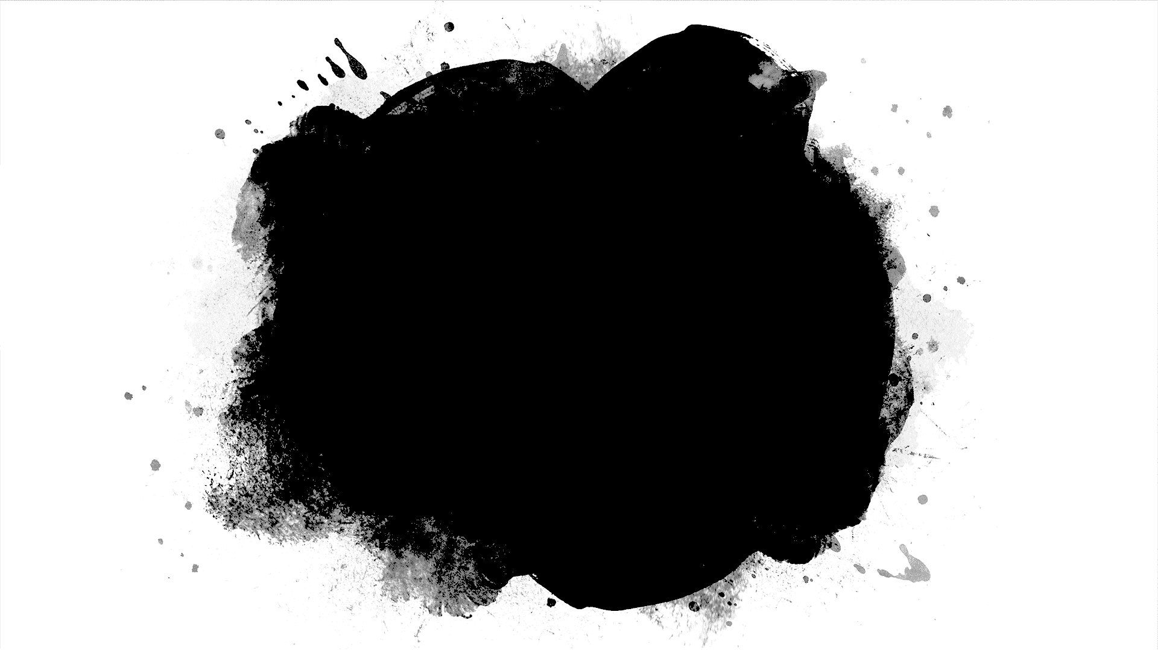
DriverPass System Analysis
Kenneth Gollaher
Notes:
[No speaker notes required for this slide.]

Slide 2
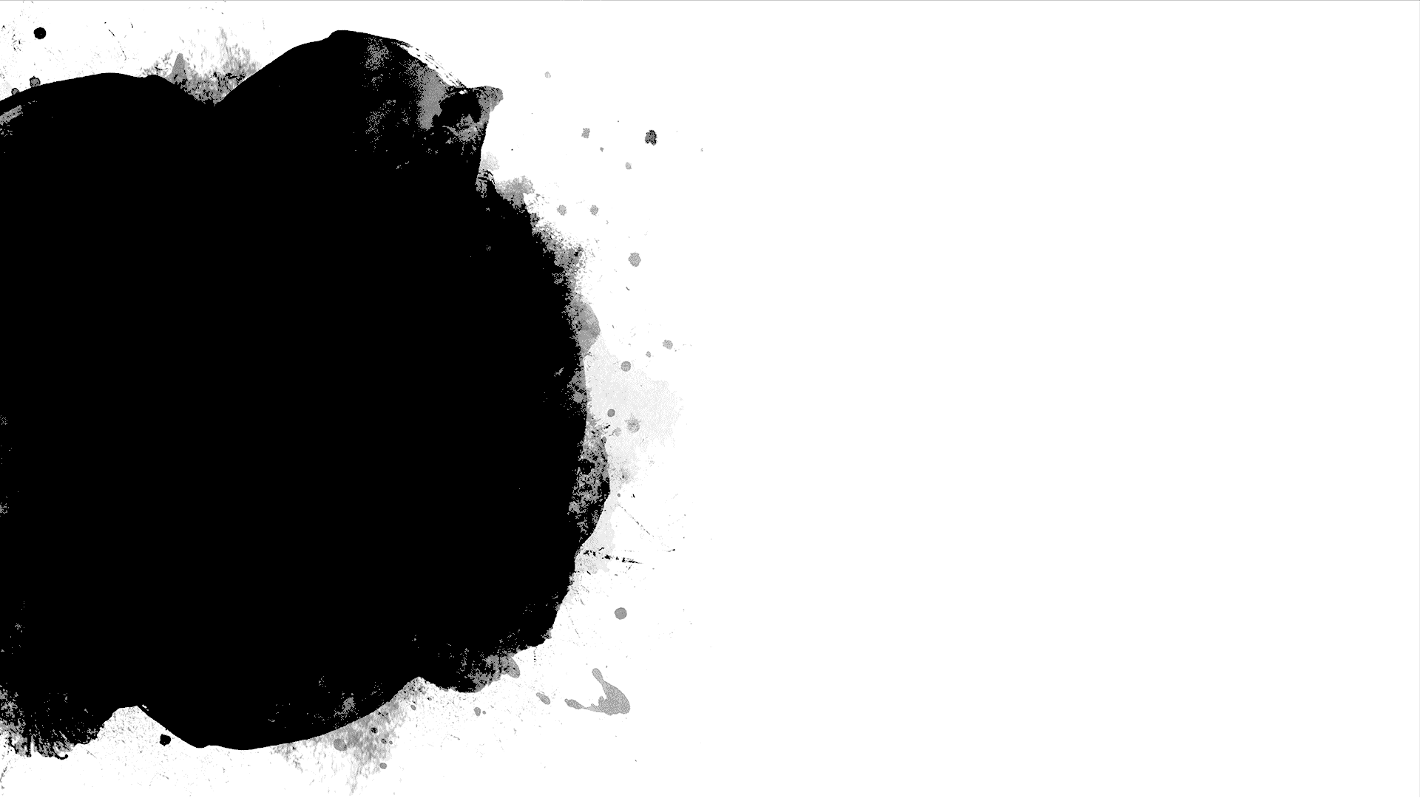
System Requirements
Functional Requirements
The system shall validate user authentication for account access.
The system shall provide authorized access depending on user credentials
Nonfunctional Requirements
The backup and security will run off a cloud-based system to reduce technical problems.
The system will need to be updated to match the DMV policies and procedures.
Notes:
The system will validate each user authentication for all account access, whether it be for students or Admin access. The system will determine the access or role of the user and provide them authorized access depending on the user credentials that are set in the system. We are using a two-step authentication, meaning the users will use a username and password to login. The server will determine whether the user has access or not.
This meets the requirement needs which allows users to have a specific role set in the system.
The backup and security will run through a cloud-based system. This will help with system security and reduce any technical issues that may arise. The system will also need to be updated to match all DMV procedures and policies. The system will receive notification from the DMV with any changes and the IT/Admin staff will update the system to reflect those changes.

Slide 3
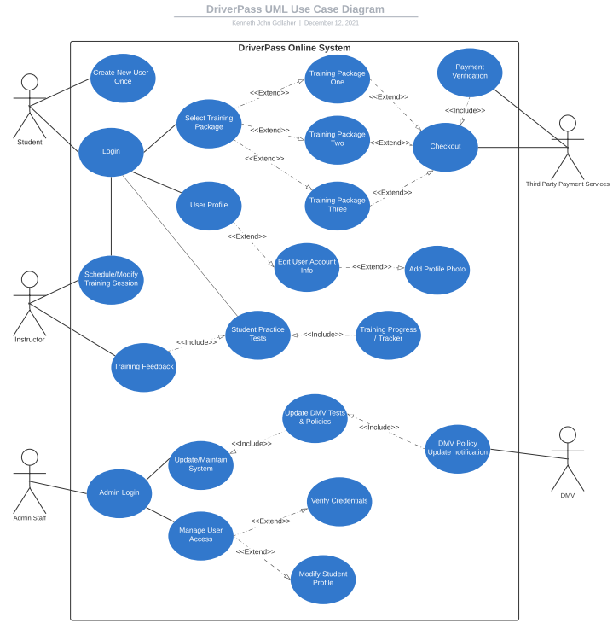
Use Case Diagram
Notes:
In our system, we have three different primary actors and two secondary actors. The primary actors include the Student, an assigned Instructor, and the Admin Staff. The secondary actors will include the Third-Party Payment Services, and the DMV. These are the different users within the system.
The Student will have actions that include login, package selection, schedule training sessions, practice tests, and will have access to view their progress. The Student will also have access to edit their user profile.
The Instructor will have actions that include modifying the training sessions and providing feedback for the Student’s progress tracker.
The Admin Staff will have actions that will give them access to the entire system so updates, maintenance, and managing user accounts will be available.
The Third-Party Payment services will just have actions verifying the payments when the user purchases a package.
The DMV will have actions that provide notifications to the Admin staff with updates of DMV policy and procedure changes.

Slide 4
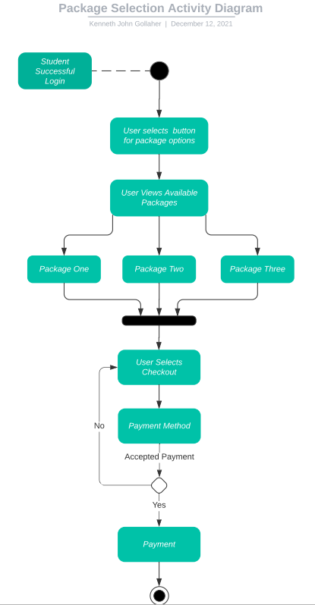
Activity Diagram
Notes:
For this slide, we will observe an important section in the online application. I have included a breakdown for the training package options and how the student will select and pay for the chosen package.
The student will successfully log into their user account. Once that is verified the student will have an option to select a training package. Once button is selected, the student will have the option to view the available training packages. In this case there are three. Once the student views each package and its details, the student will select the package and the system will continue and give the student to select checkout.
In the checkout screen, the student will enter their payment details and when all required fields are entered, the student will process the payment. The system will process the payment and determine whether it is accepted or not. If it isn’t accepted, the system will return the student to the checkout screen. If the processed payment is accepted, the payment will be sent to DriverPass.
This is the end this activity.

Slide 5
Security
Two-step authentication, i.e., username and password.
What if the user has forgotten their password?
Running on a Cloud-based System.
What if a brute force, i.e., unauthorized access, is detected?
Notes:
Security is a major concern when developing and designing a system. In our case, we are collecting personal information from each student that becomes a client. We will implement security measures that will protect the system from intrusions.
First, we require a two-step verification for the user to log into their account. This includes a username and password. The system will verify their credentials and will log the student in if the verification comes back as correct.
We will implement a backup if the user has forgotten their password and can be recovered through email if it matches the email we have in the system.
We are using a cloud-based system, and this will help with security and not reduce performance. The third-party system will be responsible for data communication between the client and the server.
If the system does detect some sort of intrusion on a user account, the system will disable the account and a notification will be sent to the authorized IT personnel set in the system. To ensure this happens, we need to ensure there is a limit of login attempts set for each user account.

Slide 6
System Limitations
Do we have enough available Resources?
Technology limitation with using a cloud-based system?
Are there any budget limitations?
Are there any timeline limitations?
Requirement changes?
Notes:
Since we are running on a cloud-based system, we will need to ensure we have enough available resources to remain on budget and that we meet the deadline. Ian (IT Officer) would like to run the application over the cloud. I foresee a technology limitation with using a cloud-based system and allowing accessibility for a variety of platforms, i.e., mobile applications as well as personal computers (laptops).
No budget was given at this time, so I assume there are no limitations for the budget developing for mobile and PC technology. With that being said, I foresee there are no timeline limitations, and we will notify you with all updates during this process.
Lastly, are there any requirement changes that need to be discussed? Any changes may affect the budget as well as the timeline and will need to be planned and implemented appropriately.

